Slide 1
Organization Details
Name of Organization : Stichting Human Point
Contact Person : Fahed Alshikh
Web : http://www.st-humanPoint.eu
Address : Rijswijk, Nederland
Polakweg7,Kamer108,2288GG
KvK-nummer 67512852
RSIN 857041162
Tele : 0031622666887
Email Address: info@st-humanpoint.nl
Bank Account Number :

Slide 2
Registration Details
Registration Number in Nederland:- KVK: 75694417 - RSIN: 860365116 ANBI
Legal Status :- Uittreksel Handelsregister Kamer van Koophandel
Date of Registration: 19-12-2016

Slide 3
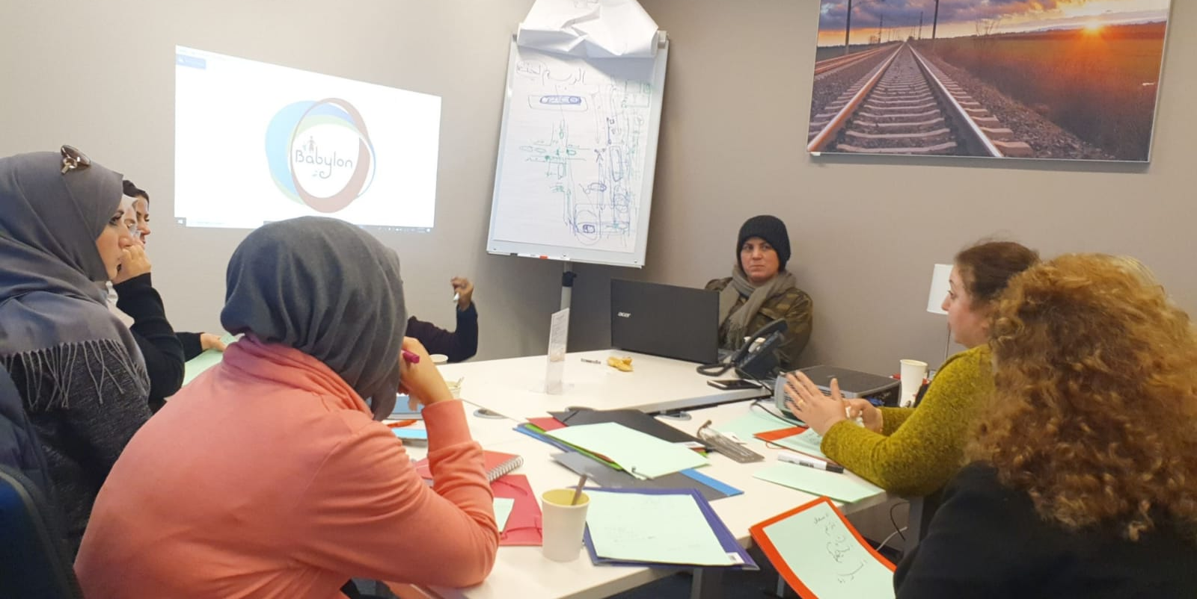
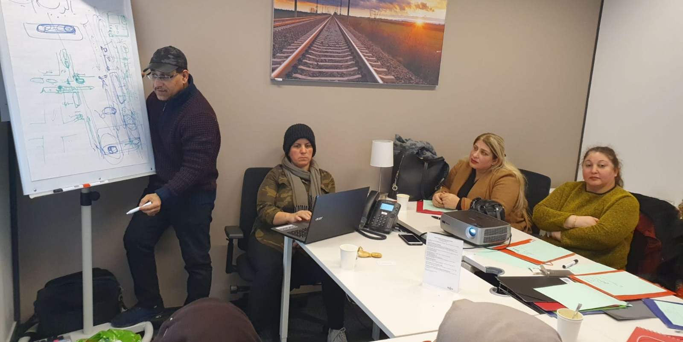
Theoretical driving course for refugees in the Netherlands

Slide 4
Personnel
Number of Board Members : 3 members
Number of Staff Members :2 members

Slide 5
Beneficiaries
Direct Beneficiaries : Children and girls in the world ; particularly orphans, poor, and Refugees and people in Nederlands.
Indirect Beneficiaries : Needy families in Baghdad Second Rusafa ; Mousl, zacho
, babyel….ect

Slide 6
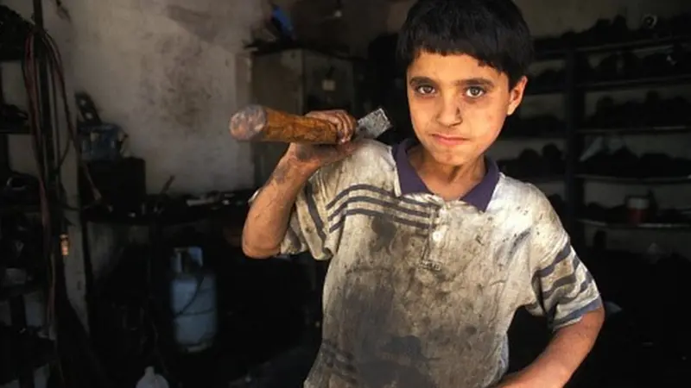
No to child labor in the world

Slide 7
Vision
For a safe educational environment for children in the poor and marginalized world. Build a society that is aware of its rights to education, because with education and work you will be pioneers in developing a decent lifestyle for poor communities in the world to attract smiles and spread hope for a new life.

Slide 8

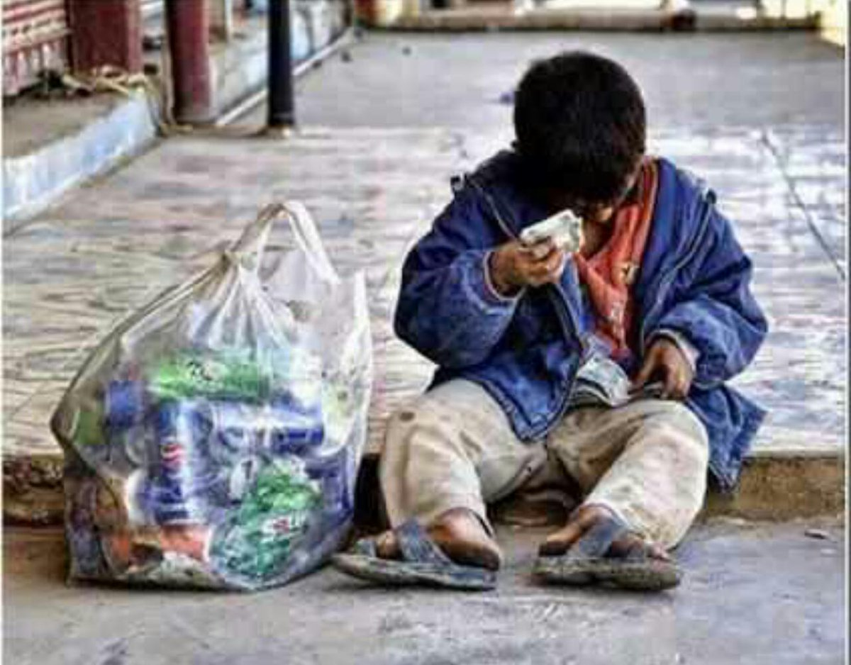
We work to help poor people in Iraq and the world
Together to save poor people
Foor the deprived childhood

Slide 9
Message
We are keen to provide the best services to create a safe educational environment, meet the educational needs of marginalized children in their communities, and develop their capabilities according to international standards to reduce child labor

Slide 10
Departments
Orphanage ;
Girls Care Department ;
Poor and Needy people Department
Vocational Training Youth Department
Emergency Department ;

Slide 11
Objectives
1- Creating a safe educational environment for marginalized and poor children in the world's countries
2- Identifying the educational needs of children to overcome the financial difficulties of their families
3- Raising awareness among children about the importance of education and studying in building their future and achieving their dreams
4. Seeking to implement projects that reduce child labor and increase the desire to return to school
5. Communicating with relevant organizations and coordinating to achieve the goals.
6. Building, renovating and equipping dilapidated schools to become suitable and attractive for study
7. Reducing the phenomenon of violence against children that leads to disrupting their studies through psychological and social support for the child and his community

Slide 12
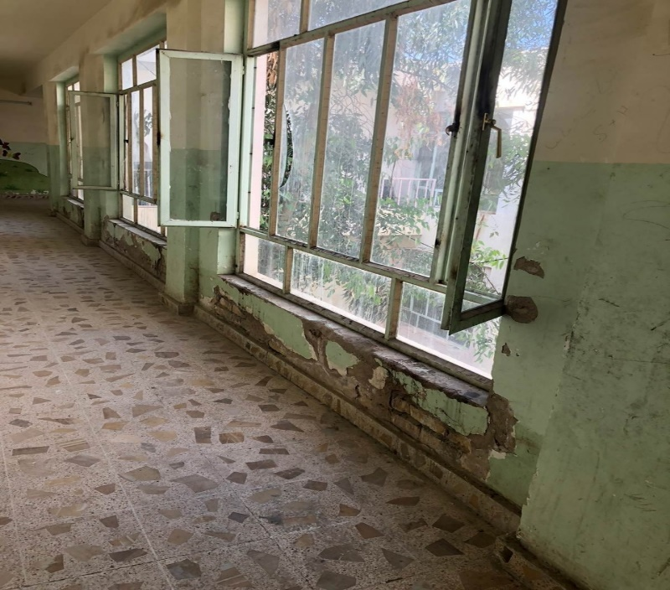
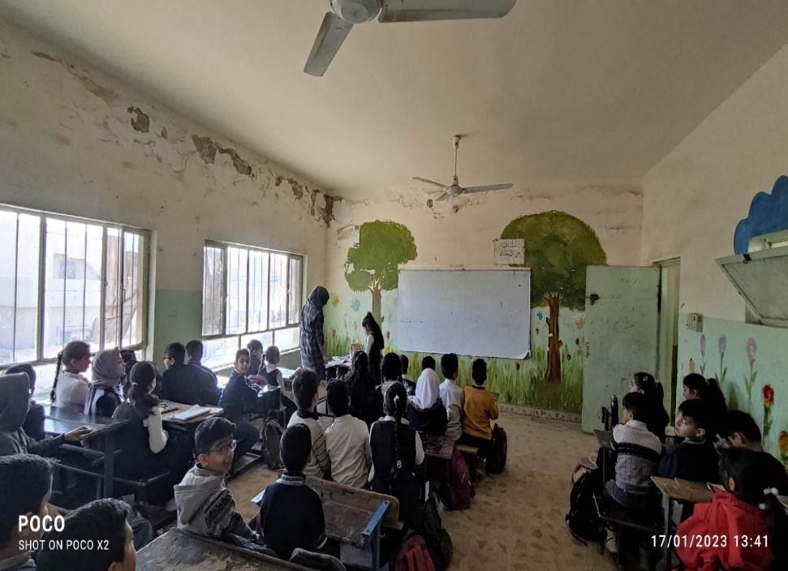
We help them create a safe learning environment

Slide 13
What method does your organization use to make decisions about setting priorities and working methods for the coming years?
Human Point seeks partnerships with local organizations that have an official status and are reliable in the countries where we work. There will be questionnaires and surveys that determine the needs of the target group based on their importance and priority. We will establish partnerships with international organizations and the United Nations to gain their trust in our work, since during the implementation of each project we will ensure the presence of a Human Point person on site and the exchange of reportsThrough consultation with government institutions, to facilitate our work and obtain the necessary approvals for our work. For this reason, we have created a planned strategic basis to continue our work successfully. A large number of children and girls have benefited from our programs.

Slide 14
Work History
Future Projects in netherlands
Theoretical driving education project in netherlands
Establishing a charity market whose proceeds go to foreign aid from the poor and orphans
Holding activities for children in Dutch schools and poor countries
Projects to build, maintain and equip dilapidated and war-damaged schools
Supplying schools with stationery and clothes to distribute to poor and needy children
Holding donation campaigns to help children complete their education
Awareness campaigns about violence against children
Projects to reduce child labor and return them to their studies
Donation and grant funds in the Netherlands

Slide 15
Futur Projects outside the Netherlands
Project to clothe children with clothes and school supplies for children in poor and marginalized communitiesMaintenance and equipping of schools in the governorates of Iraq where the illiteracy rate and school dropout rates are high due to the poor condition of schoolsProject for child labor and the return of children to schoolsProject to spread children's rights through play Courses for local organizations in Iraq to apply them practically to spread children's rights in cooperation with children's families with the participation of all organizations in Iraq

Slide 16
We need to finance future projects
-1- Charity funds in the Netherlands
2- Grants from international and UN organizations
3- Donation campaigns from people in the Netherlands
4- Holding bazaars and social invitations in the Netherlands
5- Donations from local organizations in the Netherlands and abroad
6- Donating part of the taxes on companies and institutions
7- Donating via campaigns on social media and the Internet

Slide 17
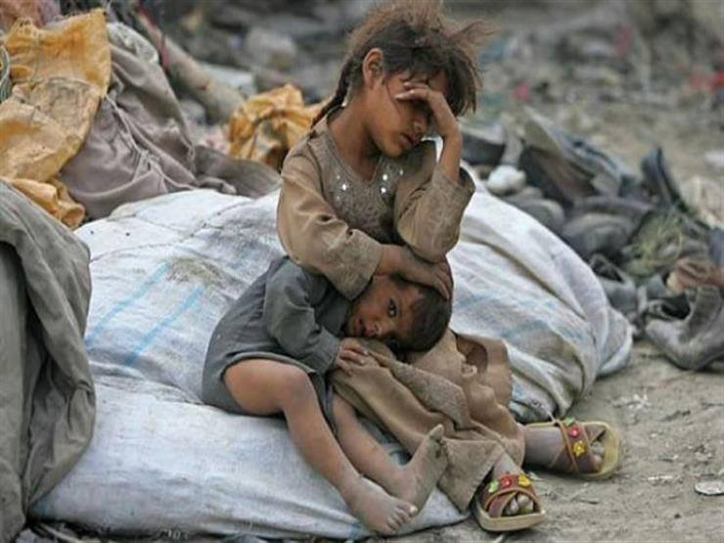
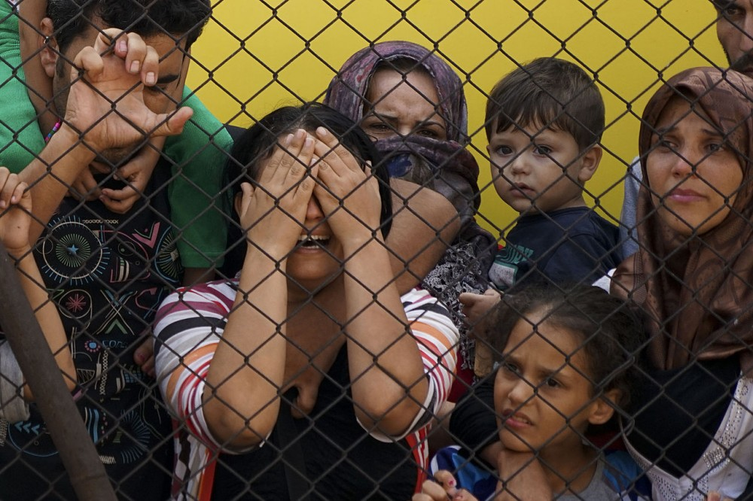
This is the state of children if they leave their studies

